Slide 1




Quick House Rules
Please mute your mics
unless you are asking
a question.
This is a space to learn, let’s respect everyone!
Ask your questions and be engaged through the session
Notes:
Before we jump into our presentation, we just have a few requests of you:
To avoid background sounds or any distraction through sound, can you please all turn off your mics unless you are asking a question.
We want to make sure that everyone feels safe and included. In all our sessions we ask that everyone shows each other respect and understanding.
This is in an information session for you! We want to make sure that we answer all your questions. If you do have one, ask by raising your hand! We are also posting in the chat! You can chat with us there!
Okay great! Who’s ready to get IT started!

Slide 2

IT Starts Here
Welcome to our information session for Job Placement & Technical Training Programs at NPower Canada. Free for young adults ages 17-30!
Notes:
(Welcome Everyone for Joining Today)
My name is: _________ . I am a __(position)___ at NPower Canada. Today, I am going to share some exciting opportunities that we have here! We are so happy to have you with us!
We have lots to talk about let’s get into IT!

Slide 3

Agenda
      Who we are
      Jobs are the Goal
      How we do it – Our programs and services
      How to refer or apply – eligibility criteria and application process
      Questions
Notes:
Go over the Agenda – Review Points
Keep this short and to the point on the agenda. Good things to say:
i.e “Jobs are the Goal and we have quite a few. We will talk more about that soon.”

Slide 4

Who we are
      NPower Canada is a national non-profit organization providing low-income, diverse young adults, aged 17-30, with job placement support FREE technical, professional and life skills training, industry certification, and 5 years of alumni career services.
Notes:
Summarize Slide as Participants are reading it and listening.
As mentioned in the Agenda we are going to talk about lots today, but this really is who we are…
We also help to identify… (a problem – i.e. Skills gap and how we bridge this)
We are going to get into all of this, but first, there are some others that we should mention who allow us to operate our programs… they are….. Our Funders! (Next Slide)

Slide 5


































Yes, it’s all free! Thanks to our funders
Visionaries
Innovators
Builders
Notes:
We always appreciate our Funders who really allow us to do this and cover the costs to make this free for you. These costs can be substantial as we are in the tech world. Thanks to our Funders continuous support, we can provide you with these important opportunities to gain the digital skills for your future tech career.
In addition to being our Funders, some of these organizations also hire our Graduates as we work to involve our Employer Partners throughout the Program to bring you even more opportunities!

Slide 6

Our Impact?
Please mute your mics for this video to allow everyone to listen in.
Notes:
Give a listen to this video about what our Employers are looking for and how
NPower Canada helps them find ideal, trained candidates.
(Play Video - https://www.youtube.com/watch?v=Agm1nyGkwNc ) – To activate in the Presentation use
CTRL + Click

Slide 7






Jobs are the goal
Technical Support Representative
$15/hr - $21/hr = $29,250 - $40,950
Compugen, IBM
Information Security Analyst
$20/hr - $25/hr = $39,000 - $48,750
RBC, Herjavec Group, TD Bank
Hardware Technician
$14/hr - $18/hr = $29,120 - $35,100
Geek Squad, Dell, EB Games
Junior IT Analyst
$15/hr - $21/hr = $29,250 - $40,950
Accenture, Deloitte, Grant Thornton LLP
Help Desk Analyst
$15/hr - $21/hr = $29,250 - $40,950
Black and McDonald, CGI, Shopify
Quality Assurance Analyst
$18/hr - $24/hr = $35,100 - $46,800
CIBC, RBC, TD Bank
Notes:
Here are some of the jobs and salary ranges for positions that our Graduates have secured.
Take a look for example at the Technical Support Representative opportunities with our incredible
partners at Compugen and IBM. These positions are average of 15-21$/hr and you can earn that by
being certified.
You can see that these are with well-established companies or organizations in Canada. You can feel
confident knowing that with these leaders in the field that you will be gaining valuable experience in
the industry.
Let’s hear from a few people! Now that you have heard about these positions – which would be the
job you are most interested in getting?

Slide 8

What’s in IT for you
Over 2,200 Graduates have done IT!
You can get:
a career in a growing IT Industry
tech training with an Industry certification in less than 4 months
5 years of post-graduation Alumni support.
Notes:
We are big, with over 2,200 graduates that have proven they can do tech too, means you can do IT just like them!
At NPower Canada we make sure to provide you with
The supports needed to begin a career in a growing IT Industry
Tech Training with a certification in less than 4 months
5 years of post-grad alumni support services
Oh and did we mention – IT is all for FREE!

Slide 9
How the Program Works
Learn about IT through our 15-week Training Programs
Earn industry-recognized IT Certifications
Hands-on Learning with support from our Instructors
Networking and Mentor opportunities
Classes are Monday - Friday 8:30-4 pm (local time) daily and is delivered virtually for learning from home.
Notes:
The NPower Canada program itself includes the following main components:
You will get the technical training through our program over the course outline of only 15 weeks.
Earn certifications such as the Google IT Support Professional Certification in our Junior IT Analyst Program or the CompTIA Security+ in our Junior Security and Quality Assurance Analyst Program.
Get hands on learning in-class with live Instructors and simulations and labs.
Networking and Mentoring opportunities are still provided by our partners virtually.
Our Programs have a lot to cover, we do require attendance online, daily during the week, Monday – Friday from 8:30 am until 4 pm in your local time. Our Programs are delivered online, each day, for learning from home.
Recruitment and Intake: NPower Canada partners with local community organizations to recruit low-income youth from diverse populations. Youth are assessed for eligibility, suitability and motivation through an online application followed by group and individual interviews. Youth deemed ineligible for the program receive warm referrals to other pre-employment programs.
Training: Participants complete 15 weeks of daily technical and professional skills training delivered through a work-simulated approach. Participants earn industry credentials and certifications. Staff and corporate volunteers also deliver employability skills training in areas like workplace communication and teamwork. Corporate partners also host site tours and job shadowing opportunities to facilitate work-based, experiential learning.
Job Placement: Upon completing training, participants are placed into full-time employment in roles such as Help Desk Analyst, Jr. Developer and Project Control Officer.

Slide 10







Junior IT Analyst Program
Beginner program - no prior IT knowledge is required
Google IT Support Professional Certification
Equips participants with the following in-demand skills:
Security | Networking | Operating Systems & IT | System Administration Infrastructure | Customer Service | Agile Project Management
Notes:
A program for everyone – no prior IT or tech knowledge required.
The Junior IT Analyst Program equips program participants (17-30 years old) for a diverse range of technology career pathways through new curriculum delivered in partnership with Google.
This Program is completion-based meaning there is no large (final) exam at the end. Instead, after all your modules are completed, you will the earn the certification.
During the Program you will Learn the following skills:
User Support, Networking and Cloud Fundamentals
Systems Administration, Cloud Infrastructure and IT Service Management
IT and Network Security
Graduates can secure roles such as:
Junior IT Analyst
Help Desk Specialist
Service Technician
Customer Care Agent
Project Analyst
Junior Systems Administrator

Slide 11



Junior Data Analyst Program
Intermediate program - some prior IT/technical and/or programming knowledge is required.
Learning Excel for VBA and SQL along with Python for Applied Data Science.
Microsoft Azure Fundamentals Certification
Notes:
The Junior Data Analyst Program, co-sponsored and designed in partnership with Microsoft, equips young adults (17 - 30 years old) for Junior Data Analyst roles, focusing on SQL, Microsoft Azure and Python for data analysis, cloud and AI scripting.
This Program is a little bit different as it is exam-based meaning there is a final exam at the end. This exam must be passed in order to earn the certification.
This program equips participants with the following in-demand skills:
Excel, VBA and SQL Fundamentals for Data Science
Python for Applied Data Science and AI
Microsoft Azure AI Solutions
Graduates will secure roles such as:
Junior Data Analyst
Help Desk Specialist
Junior Database Developer
Business Analyst
Project Analyst
Junior Database Administrator

Slide 12



Junior Security & QA Analyst Program
Intermediate program - some prior IT/technical and/or programming knowledge is required.
CompTIA Security+ Certification
Cisco Cybersecurity Essentials Certification
Learn Strategies for preventing, identifying and resolving a wide range of vulnerabilities, security evasion techniques and security monitoring operational challenges.
Notes:
The Junior Security and Quality Assurance Analyst Program equips program participants (17 - 30 years old) for a diverse range of technology career pathways in information security, quality assurance and IT support services.
Like our Junior Data Analyst Program, this Program is also exam-based with a final exam at the end. This exam must be passed in order to earn the certification.
Learning outcomes include:
Information Security Foundations: Security+ Certification
Application Security, Testing and Quality Assurance
Graduates will secure roles such as:
Junior QA Analyst
Customer Care Agent
Junior Application Tester
Information Security Analyst
Help Desk Technician
Junior Software Tester

Slide 13
Professional Skills & Life Skills
Professional Skills
Life Skills
&
Resume Writing
Self Care
Interviewing & Networking
Goal Setting
Personal Branding
Budgeting
Business Writing
Time Management
Teamwork and Conflict Resolution
Stress Management
Notes:
In addition to our technical training, NPower Canada supports the development of your Professional skills such as…..
We also help you build your best self and develop your Life skills by discussing time management, stress management….

Slide 14
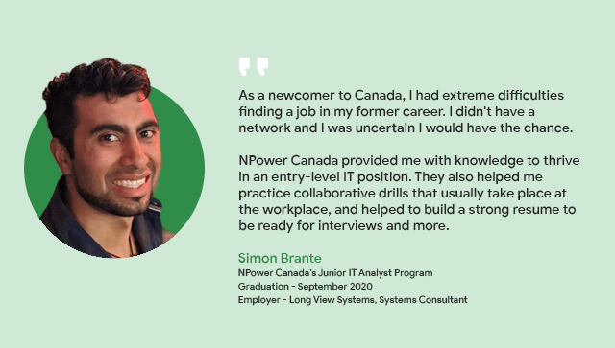
Notes:
These professional and life skills prepare you for real-world environments in and
out of tech. Having these skills like networking is incredibly valuable.
For examples, let’s look at our Alumni, Simon.
Simon was a newcomer to Canada
He didn’t have a strong network, or networking skills like we teach at NPower
Canada. When he came to NPower Canada – he needed a network to find
opportunities NPower Canada provided him with not only the technical training he
needed to start in tech, but also with the professional development and life
skills training that was essential for him to be successful in securing employment
with Long View Systems in Calgary.
Opportunities are at NPower Canada, so what does this really mean for you?

Slide 15

5 Years of Alumni Support
Post-hire coaching and mentorship
Alumni upskilling programs
Growing network of 2,200 graduates
Opportunities to pay it forward
Earn referral rewards
Notes:
After graduating from one of our Technical Programs, and to support your career growth, we also have services for our Alumni! For 5 years after graduation, we offer:
Post-hire coaching and mentorship
Career assistance with job advancement search, interview prep, and salary negotiation.
Professional workshops and events.
Our Alumni Engagement Services team will be working with you to create your career discovery profile and discuss opportunities available.
Alumni programs
Opportunities to upskill with advanced programs on emerging technologies - only available to alumni. – Google Automation with Python we will talk about this in a few moments.
Growing network of 2,200 graduates ( Show off that you are our Alumni – Pride, being proud)
Connect with peers and new opportunities through our Alumni Engagement Groups on LinkedIn and Instagram. Staying connected with your peers from class is important to continue strengthening your network. (Staying top of mind with your peers and friends if you are active online)
Alumni also share your experiences and certifications on Social media where you can celebrate with your peers.
Pay it forward and share your story
Join as a panelist, guest speakers and mentor as well as earning rewards for referring friends or family, maybe even those in your networks that qualify for our programs.
By the time you graduate you will have an amazing story to tell about your experience with NPower Canada. We want to hear your story and share it with others!

Slide 16

Alumni Program
Google Automation with Python Program
NPower Canada graduates learn in-demand skills in Python programming, automation and Cloud configuration. Learning outcomes include:
Write simple Python programs
Apply Python and Linux to real-world scenarios
Learn configuration management for computers at scale using Puppet
Learn how to leverage external Python modules to expand code capabilities.
Learn more at npowercanada.ca/alumni/
Notes:
Alumni programs
Opportunities to upskill with advanced programs on emerging technologies - only available to alumni. – Google Automation with Python
Talk about it being another free, more advanced certification that NPower Canada offers after successful completion of any core youth program- to learn and grow further. This program also offers more flexibility to learn at your own pace helping to support other components in your life, such as work or personal obligations, compared to an assigned schedule that our Junior IT Programs require.

Slide 17
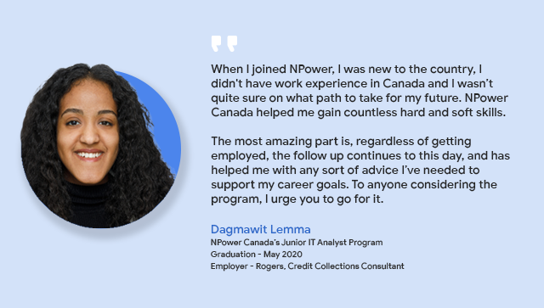
Notes:
Here is one of our Graduates Dagmawit,
Dagmawit was also a newcomer to Canada like Simon
She wasn’t sure on where to go because she had no experience
When she came to NPower Canada – we helped her gain hard and soft skills.
NPower Canada provided her with the technical training she needed with the professional development
and life skills training that was essential for her to be successful in securing employment with Rogers in
Toronto.
As great as this all is, we are able to serve those who need us the most! So what makes you eligible?

Slide 18
Program Eligibility Criteria
Young adults 17-30 years old.
Must have high school diploma or GED, earned inside or outside of Canada;
Unemployed or underemployed (working less than 25 hrs per week).
Facing financial challenges and barriers to employment.
Advanced English language proficiency – Canadian Language Benchmark (CLB) of 7 or higher in speaking, listening, reading and writing.
Notes:
Discuss the Program Eligibility Criteria Slide

Slide 19
Program Eligibility Criteria
Applications strongly encouraged from members of equity-seeking groups including women, Black, Indigenous and other racialized youth, LGBTQ2S+ youth and youth with disabilities.
Cannot be in full time work or full-time school
Must be legally able to work in Canada
Strong, demonstrated motivation to work and learn.
Notes:
Discuss the Program Eligibility Criteria Slide
*NOTE* - Legally able to work in Canada:
- We accept Canadian Citizens, Permanent Residents, Convention Refugees, Refugee Claimant and Work Permit Holders. Anyone who needs a work permit must have a minimum of 9-months available on their work permit from the start date of the program.

Slide 20

Next programs start
September 20th!
Notes:
You can change dates and add local programs to this slide as needed
Get excited that we are accepting applications!
We have three intakes per year happening in January, May and September.
Apply Today though as our programs are competitive!
What can you do??

Slide 21


NPower Canada - Alumni
Leul - Jr. Data Analyst Graduate - May 2021
Winne - Jr. Data Analyst Graduate - May 2021
Notes:
Complete the online application - Once you apply someone on our admissions team will call or email you directly.
Interview - Once you apply an Admissions staff person will contact you as part of our selection process. We will then notify you of the final decision and invite you to an interview.
Make sure to check your spam folder if you do not initially hear from us in the 24-72 hours as some emails block or filter these out.
Does anyone have any??

Slide 22
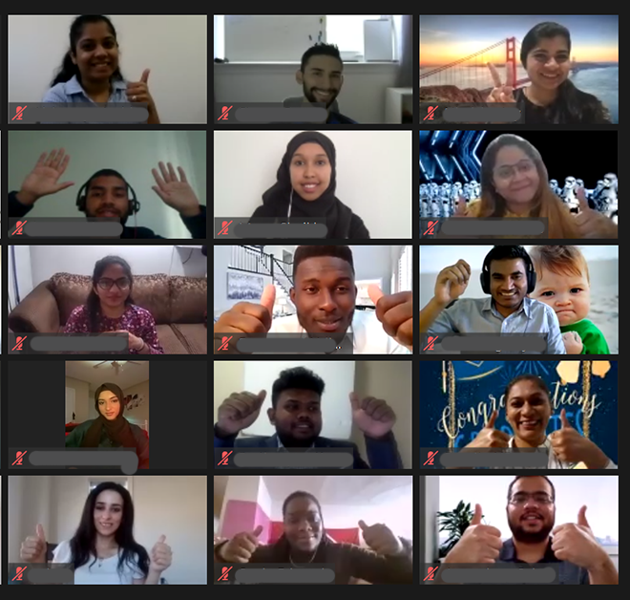

Apply Now!
Apply online!
https://npowercanada.ca/youth/
You will receive an email from the Admissions Team – Thanks for applying
Follow-up from the Admissions team in 24-72 hours
    If you do not receive an email please check your spam folder
Notes:
Complete the online application - Once you apply someone on our admissions team will call or email you directly.
Interview - Once you apply an Admissions staff person will contact you as part of our selection process. We will then notify you of the final decision and invite you to an interview.
Make sure to check your spam folder if you do not initially hear from us in the 24-72 hours as some emails block or filter these out.
Does anyone have any??

Slide 23

Questions
?
Notes:
Questions for me today?
FAQs - the most common questions we get on our programs can be found on our website and you can also send additional questions if you have any to info@npowercanada.ca

Slide 24




Thank You!!
Harpreet Dayal – Outreach Specialist harpreet.dayal@npowercanada.ca
Call/ text - 403 479 2129
@npowercanada
Notes:
Thank you so much for listening and joining us online today!
I’m _________ once again, it’s been great to meet you all. Here is my contact information, please feel free to reach out if you have any questions related to our Programs or the Admissions Process.
Also, visit us on at least one of our profiles on social and follow us to continuing seeing more exciting IT news from NPower Canada. Our handle is the same across all platforms @npowercanada that’s n-p-o-w-e-r canada, go follow us today!
(Close out Presentation as per normal)

